Slide 1
Dangling and Misplaced Modifiers

Slide 2
Modifiers
What is a modifier?
A modifier is an expression that describes another word or phrase
Example: little boats (little describes the boats.)

Slide 3
Misplaced Modifiers
A misplaced modifier is a word or phrase placed next to some other word or phrase that it does not intend to modify:
There was a debate regarding the bill to provide aid to homeless people in the senate.
Wait. There are homeless people in the senate?
Revise a misplaced modifier by moving the modifier next to the word it is actually modifying:
There was a debate in the senate regarding the bill to provide aid to homeless people.

Slide 4
Misplaced Parts
Modifiers such as almost, only, just, even, hardly, nearly, and merely, should be placed immediately before the words they modify.
Example:
My mother only works on Saturdays and Sundays.
This sentence indicates that the mother only works -- she does not eat, sleep, or talk.

Slide 5
Misplaced Parts
We must place the modifier before a different word so the sentence is clearly understood.
Ex.: My mother only works on Saturdays and Sundays.
Revised: My mother works only on Saturdays and Sundays.

Slide 6
Misplaced Phrase
Example…..
Her job is to file newspaper
articles about handgun use
in the library.
A modifying
phrase should
clearly indicate
what the phrase
modifies.
Revised…..
Her job in the library is to file newspaper articles about handgun use.

Slide 7
Modifying Clauses
Modifying clauses should be
placed near the words they modify.
Revised…..
Before the class
begins, the librarian
explains
how they use the
computer to
do research.
Example…..
The librarian explains
how they use the
computer to do research
before the class
begins.

Slide 8
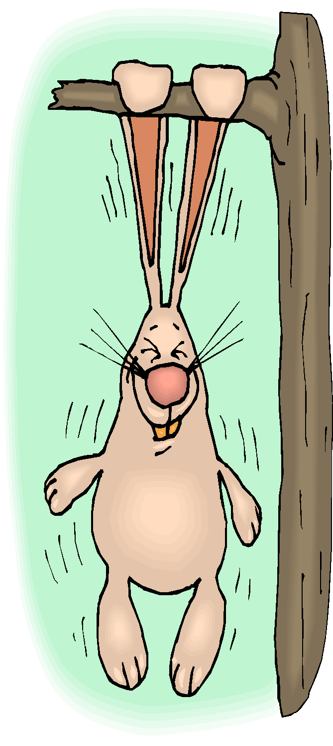
Dangling Modifiers
Dangling modifiers are words or phrases which “dangle” because they have no word in the sentence to describe:
While taking a shower, the doorbell rang.
The doorbell was taking a shower?

Slide 9
Revise Dangling Modifiers
Revise a dangling modifier by adding a headword – the noun or pronoun that is being described:
While I was taking a shower, the doorbell rang.
While taking a shower, I heard the doorbell ring.

Slide 10
How to correct DM.
Decide on a logical subject, and do one of the following:
1. Place the subject right after the opening word group.
OR
2. Place the subject within the opening word group.

Slide 11

Dangling Modifiers
Here’s an example:
Jumping from limb to limb, the spectators at the zoo were delighted by the monkeys.
(The spectators weren’t jumping, were they?)

Slide 12
Dangling Modifiers
Incorrect:
Jumping from limb to limb, the spectators at the zoo were delighted by the monkeys.
Correct:
Jumping from limb to limb, the monkeys delighted the spectators at the zoo.
How did the sentence change?

Slide 13
How to correct DM
We put the subject right after the opening word group.
While monkeys were Jumping from limb to limb, the spectators were delighted by them.
Or
While monkeys were Jumping from limb to limb, they delighted the spectators.

